Slide 1
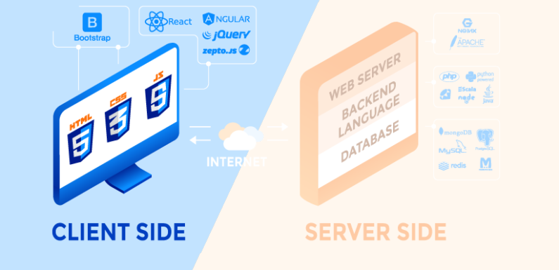
Unit 1
INTRODUCTION TO CLIENT-SIDE PROGRAMMING
DESARROLLO WEB EN ENTORNO CLIENTE 24/25
ALEJANDRO VIANA RÍOS
Alejandro Viana Ríos - 22/9/24 - v0.7

Slide 2

Unit 1
Index
Introduction to client-side programming
Basic concepts
Static vs dynamic websites
Frontend vs backend
Frameworks
Introduction to client-side programming
Scripting vs programming languages
Low-level, mid-level and high-level language/script
Programming tools
Introduction to JavaScript
What is JavaScript?
What in-browser JavaScript can and can’t do?
JavaScript versions
JavaScript engines
JavaScript-based languages

Slide 3
1.- Basic concepts
Static vs dynamic websites
Frontend vs backend
Frameworks

Slide 4
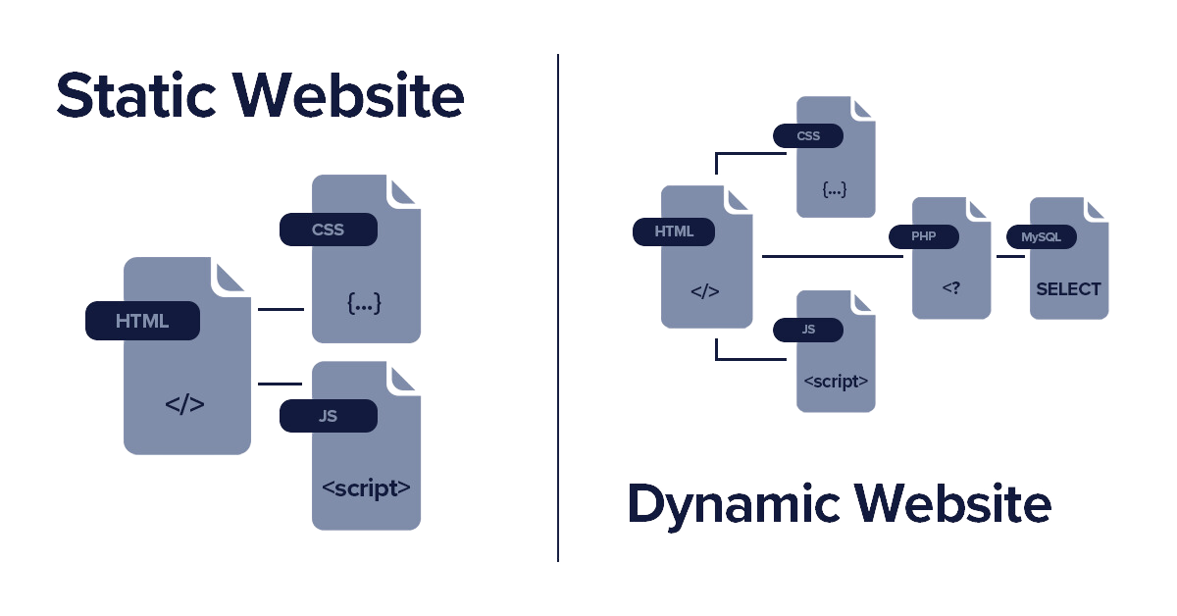
Static vs dynamic websites
3.- Introduction to JavaScript > Static vs dynamic websites
Static websites
Web page is already present in the server with the information fullfiled
Client gets web page from server
Renders it and shows to the user
It may have a small interaction, but information don’t change
Dynamic websites
Web page is not present in the server when the client ask for it
When client requires a web page, the server creates it by connecting to a database
Every time a web page is required, it could be different depending on user, time, settings...

Slide 5
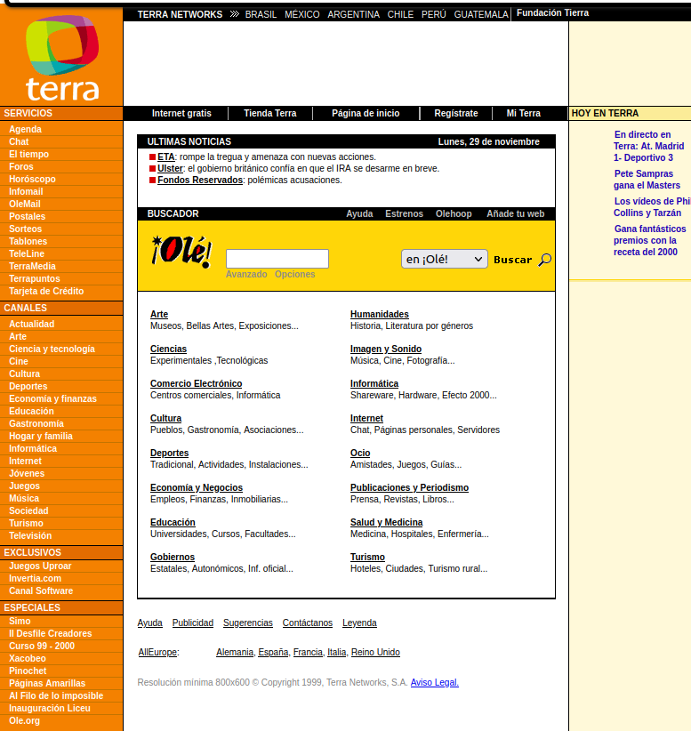
Front-end
1.- Basic concepts > Front-end vs Back-end
What is?
Client-side part of a web application
Everything a user sees and interacts with
How fast the website loads
How easy and confortable it is to navigate through it
How accessible it is to people with disabilities.
Why is so important?
Clients may run away, never to be seen, if a bad user experience is provided
Where could I get more information?
Diseño web en entorno cliente (DWEC, 2º DAW)
Diseño de interfaces web (DIW, 2º DAW)
Back on the 1990's, all sites that wanted to be on the top offered a lot of information. It was not easy to find the information you were looking for nor navigate through them

Slide 6

Front-end
1.- Basic concepts > Front-end vs Back-end
Developer tasks
Create a style guide (typography, images, colors, etc.)
Create a user interface that matches brand’s identity
Create a website usable and accesible on a wide variety of devices, browsers, connections and screen widths.
Usable: optimized load times, easy interaction...
Accesible: people with disabilities
Developer skills
Knowledge of your target audience and demographic.
Visual creativity
Prefer artistic side of the job
Careness about how users feel

Slide 7
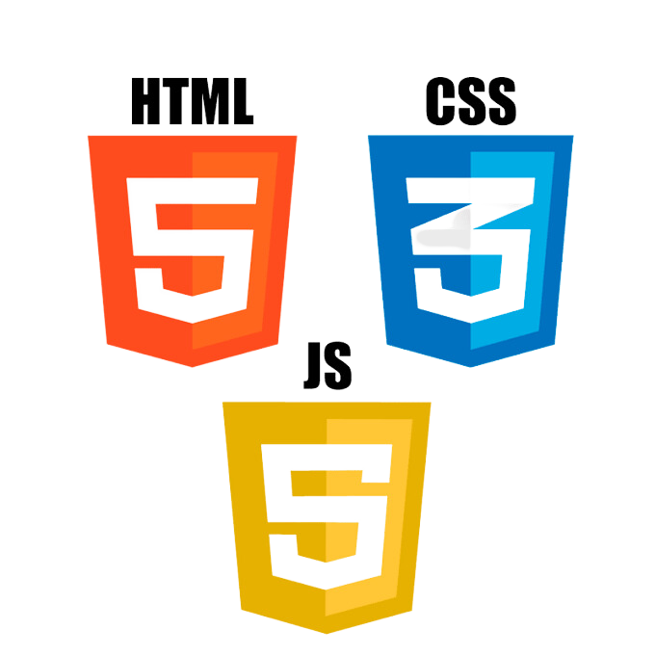
Front-end technologies for static websites
1.- Basic concepts > Front-end vs Back-end
HTML 5. Markup language used for structuring and presenting content on the World Wide Web
CSS 3. Language used for describing the presentation of an HTML document.
JavaScript ES6 or avobe (up to ES13). Language used to provide interactivity to a web site

Slide 8
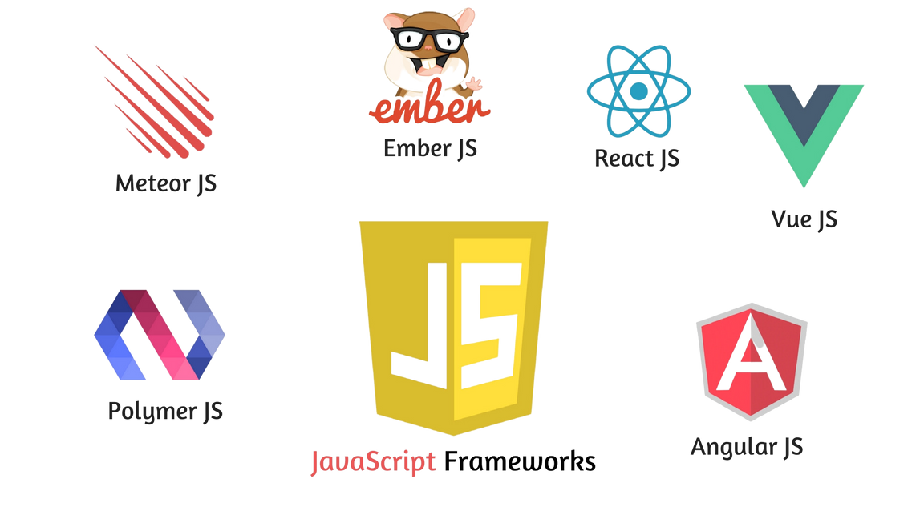
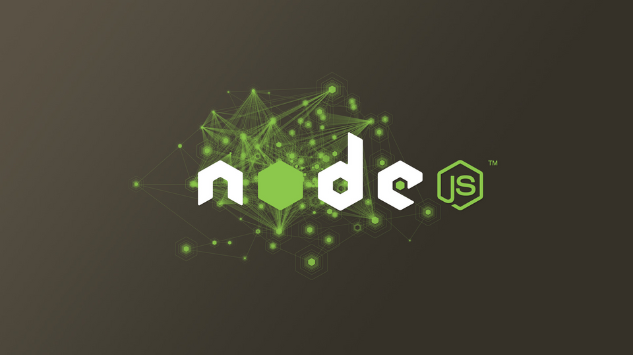

Front-end technologies for dynamic websites
1.- Basic concepts > Front-end vs Back-end
JavaScript ES6 or avobe (up to ES13)
Frameworks (Vue, Redux, Angular, etc) (DWEC). Set of tools, focused on a programming language, to support and aid on building software
Libraries (Node.JS, JQuery, etc.). Pieces of functional code, already proven, free and ready to be used on a project.
Prototyping (Figma, Sketch, etc.) (DIW)

Slide 9
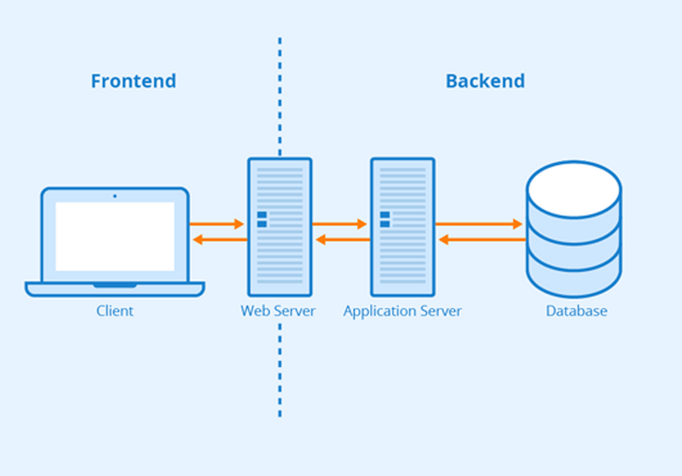
Back-end
1.- Basic concepts > Front-end vs Back-end
What is?
Server-side part of a web application
Related with how data is stored and manipulated
Algorithm that determines what application does
Why is so important?
Responsible of presenting data to client
Responsible of how the website behaves and what it allows to users
Bad design could leave website unusable or slow
Frontend and backend. It is common that web server, application server and database server are hosted on the same server

Slide 10
Back-end
1.- Basic concepts > Front-end vs Back-end
How does it work?
A server (web server) is listening for incoming requests from the client (web browser)
Server-side scripts processes the request
They collects data from database, process it and send it to the client
Frontend and backend. It is common that web server, application server and database server are hosted on the same server
Where could I get more information?
Diseño web en entorno servidor (2º DAW)

Slide 11
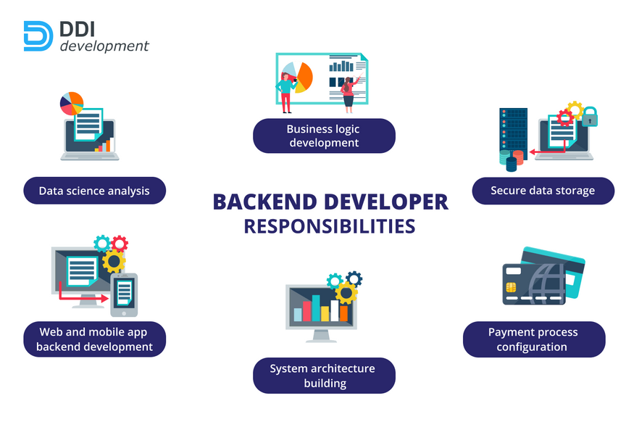
Back-end
1.- Basic concepts > Front-end vs Back-end
Developer tasks
Creating, managing, and maintaining the database
Installing and mantaining servers
Creating scripts to develop website functionallity
Working with APIs that, usually, support CRUD opperations
Interacting with third-parties services
Developer skills
Problem-oriented profile
Structured, analytical and methodical person
Proeficiency analyzing and organizing large amounts of data

Slide 12
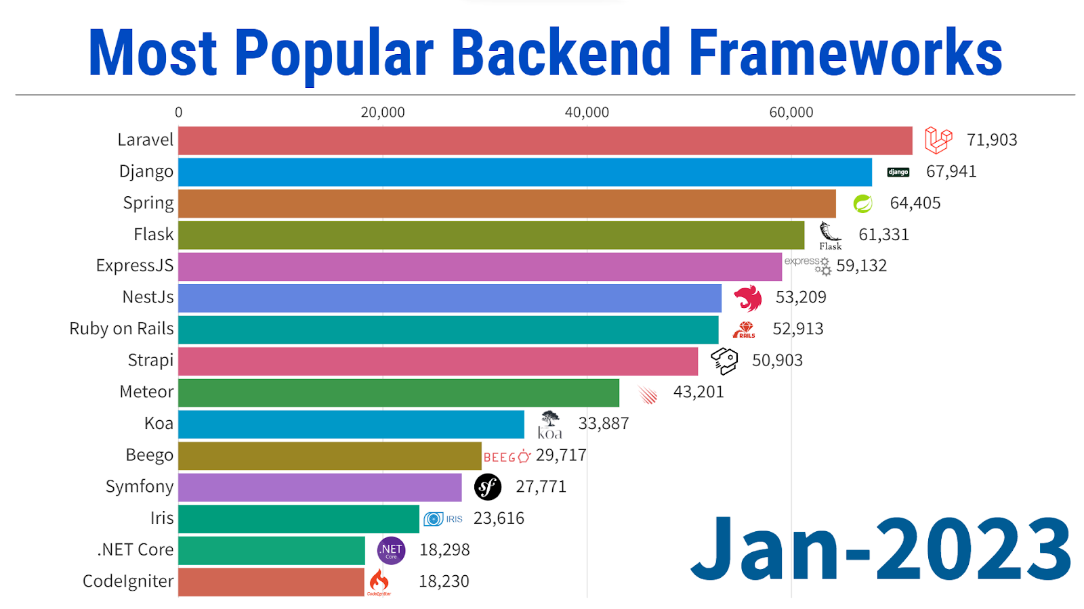
Back-end technologies
1.- Basic concepts > Front-end vs Back-end
Backend frameworks. A framework is a Set of tools, focused on a programming language, to support and aid on building software

Slide 13
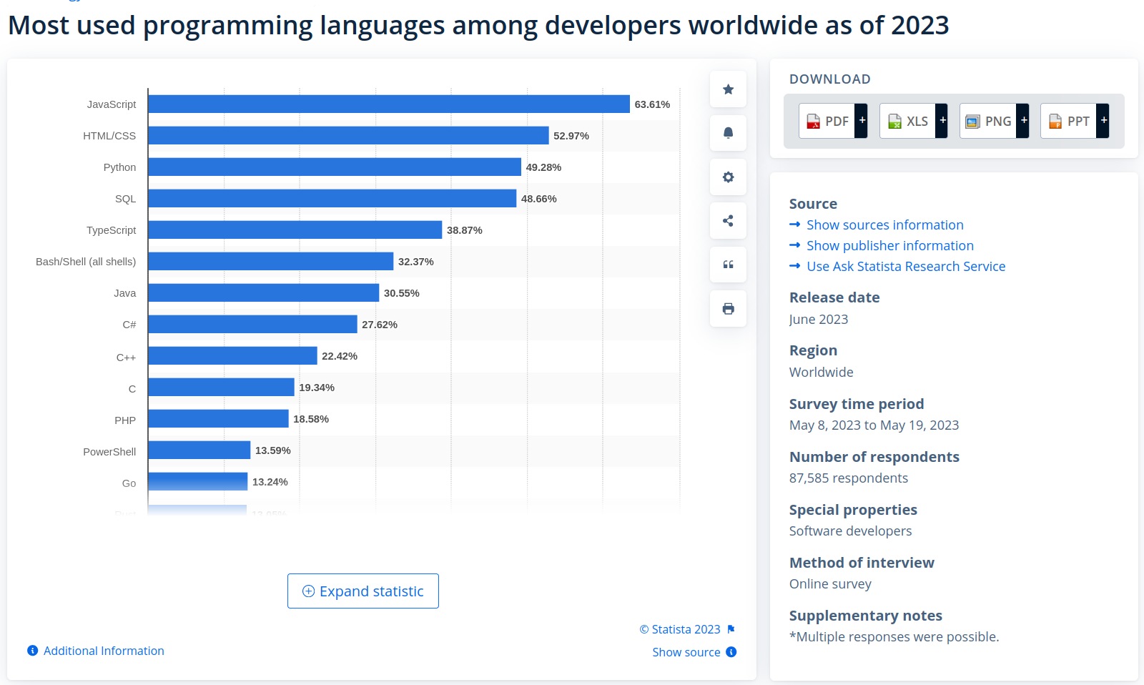
Back-end technologies
1.- Basic concepts > Front-end vs Back-end
Backend most used programming languages. Yes, Javascript. Thanks to Node.js

Slide 14
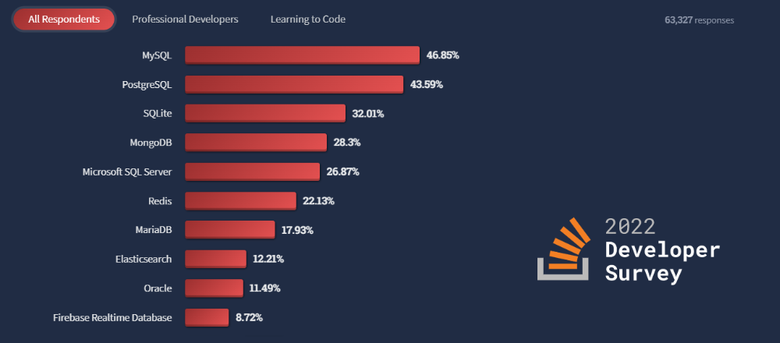
Back-end technologies
1.- Basic concepts > Front-end vs Back-end
Backend most used database servers

Slide 15
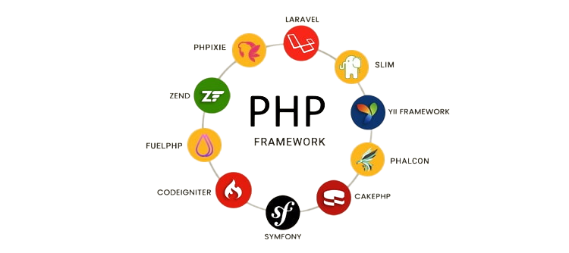
Frameworks
1.- Basic concepts > Frameworks
What is a Framework?
Software that helps to build software
Provides a scaffolder to work with
Provides aids, tasks and programs that speeds up software building
Each one is usually focused on one programming language
Javascript Frameworks
PHP Frameworks

Slide 16
Frameworks
1.- Basic concepts > Frameworks
Advantages of using a Framework
you can focus on the core software development rather than the details
It saves time
Reduces the number of errors
It’s easier to collaborate with colleagues
Avoids redundant software
Helps to write clean and secure code
Javascript Frameworks
Disadvantages of using a Framework
the code is not optimal
you lose control over your code
PHP Frameworks

Slide 17
2.- Introduction to client-side programming
Scripting vs programming languages
Programming language levels
Translating languages
Programming tools

Slide 18
Scripting vs programming code
2.- Introduction to client-side programming > Scripting vs programming code
Scripting language
Programming language
Used to automate tasks (maybe interacting with applications)
They are interpreted
Less code-intensive
Every scripting language is a programming language (not the other way round)
Have limited access to computer resources
Used to create applications
They are compiled
More code-intensive
Have unlimited access to computer resources
Examples
C, C++, C#, Java...
Types
Server-side: PHP, Ruby, Phyton, (JavaScript)
Client-side: JavaScript, CSS

Slide 19
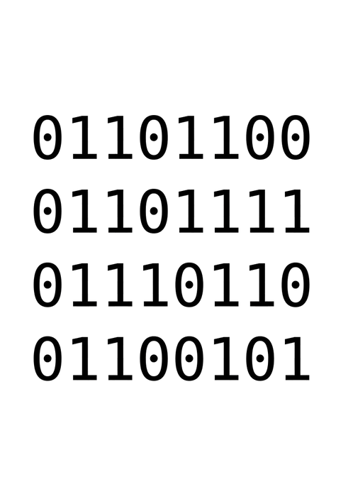
Low-level programming language
2.- Introduction to client-side programming > Programming language levels
Code is expressed in binary and uses CPU instructions set
Advantages
Directly executable by CPU. No translation needed
Execution is the fastest possible
Code is optimized for this architecture (a group of CPUs)
Lightweight code
Disadvantages
Difficult to understand by people
Difficult to express a real world problem in terms of a low-level code
Prone to make mistakes
Code is CPU dependant. New CPU requires new code

Slide 20
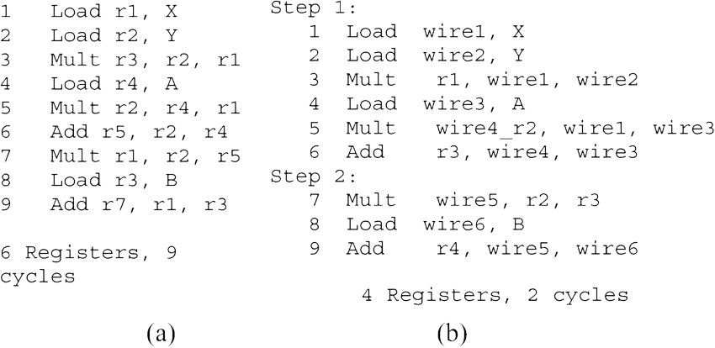
Mid-level programming language (assembly)
2.- Introduction to client-side programming > Programming language levels
Nemotecnics and variable names are utilized to make programming easier
Advantages
Easier to code with than binary
Disadvantages
Code utilizes nemotecnics, so it needs translation. CPU does not understand it
Not the best performance, neither the worst
Easier for programmers to understand and to solve real life problems than low-level but still difficult
Code can be executed only on the same architecture (a group of CPUs)
Code weights a little bit more

Slide 21
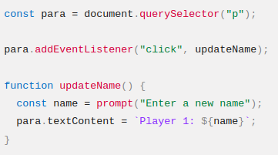
High-level programming language
2.- Introduction to client-side programming > Programming language levels
Advantages
The easiest to code with
Programmers can easily express real life problems and understand code
Code can be executed on several CPUs, even from different architectures
Disadvantages
Code needs translation (compilation or interpretation). CPU does not understand it
Code weights a lot more
The worst performance. Code is not optimized at all
a Javascript code
Examples
PHP, C, C++, C#, Java, JavaScript, ...

Slide 22
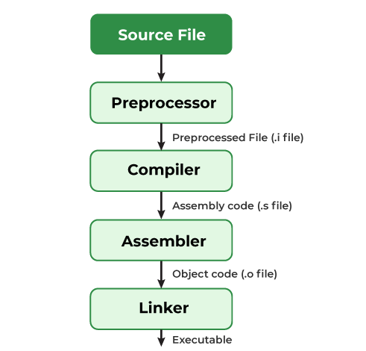
Compilated languages
2.- Introduction to client-side programming > Translating languages
Compilation
All code is translated (compiled) using several stages, and stored in one executable architecture-dependant file.
If executing in another architecture is needed, code must be recompiled (with a compiler for this architecture)
Once executable file is obtained, it is fast to execute the program
Advantages
Once obtained executable, it is fast to execute the program
All errors are detected before execution
Disadvantages
It can be slow to get the executable file

Slide 23
Interpreted languages
2.- Introduction to client-side programming > Translating languages
Interpretation
Interpreter takes a line, search for errors, optimize it, translate it into machine code and execute. No file is created nor stored
If executing in another architecture is needed, an interpreter for such architecture executes source code must
Advantages
Memory efficient
Quick to start executing
Disadvantages
At the end executing is slower

Slide 24
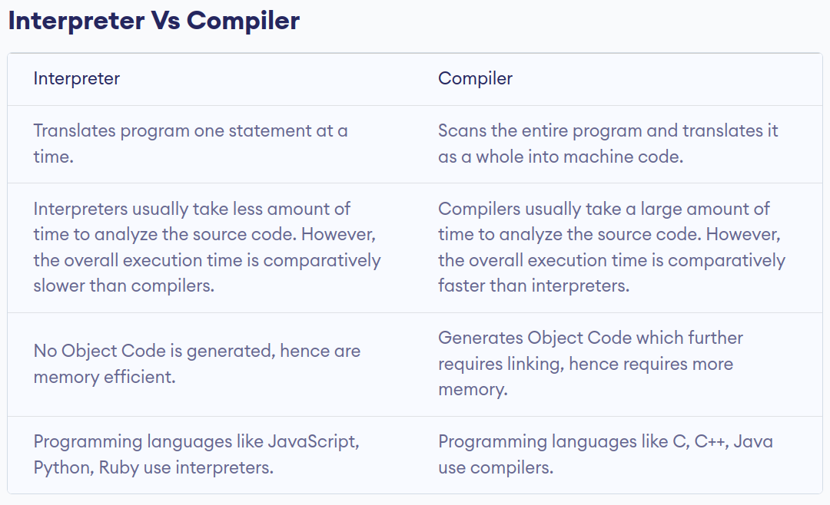
Interpreted vs compiled languages
2.- Introduction to client-side programming > Translating languages

Slide 25
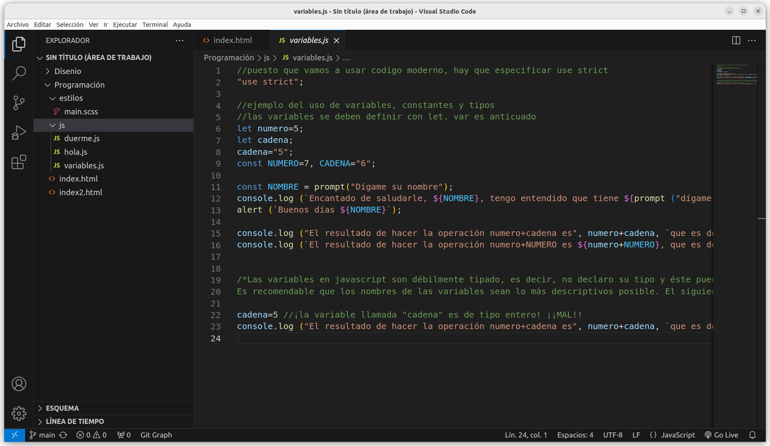
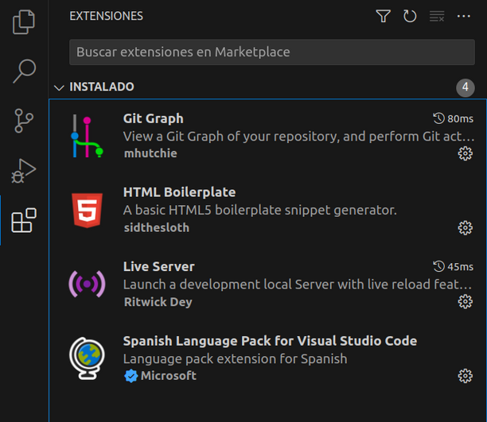
Writing code
2.- Introduction to client-side programming > Programming tools
Visual Studio code is a powerful code editor with lots of extensions and aids

Slide 26
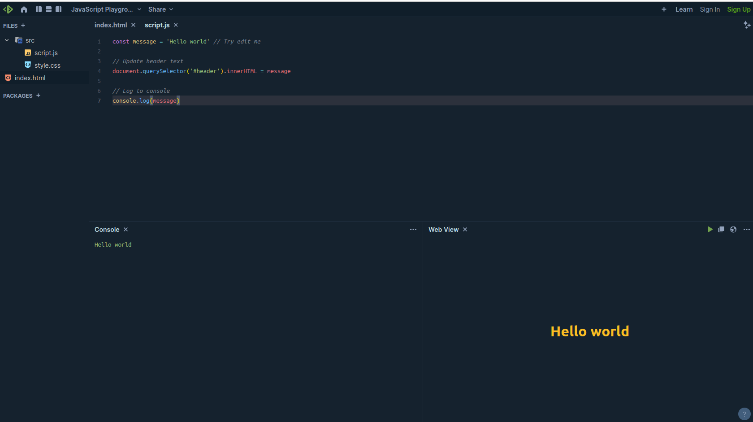
Testing code
2.- Introduction to client-side programming > Programming tools
Playcode is a powerful online JavaScript (among others) execution environment

Slide 27
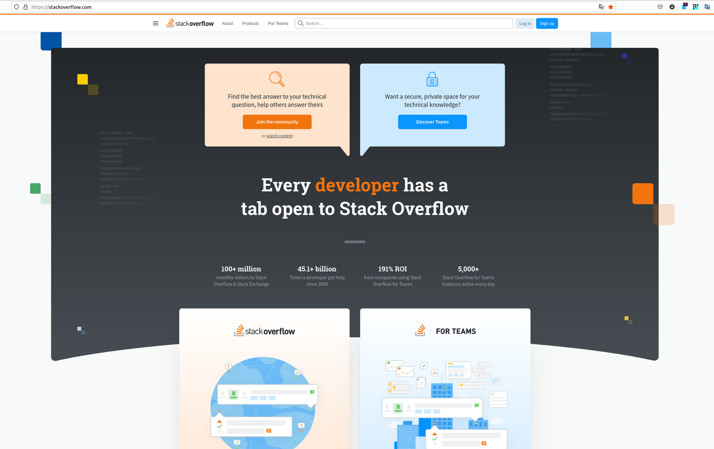
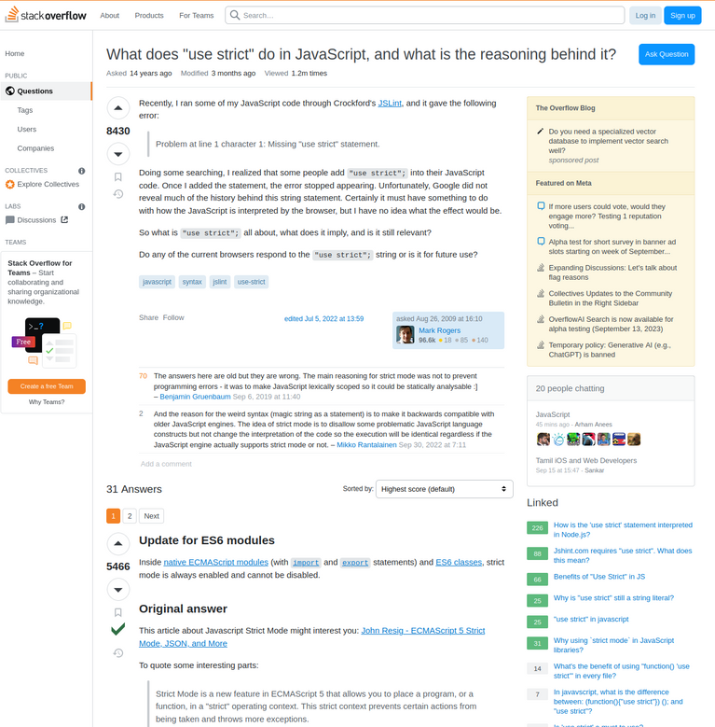
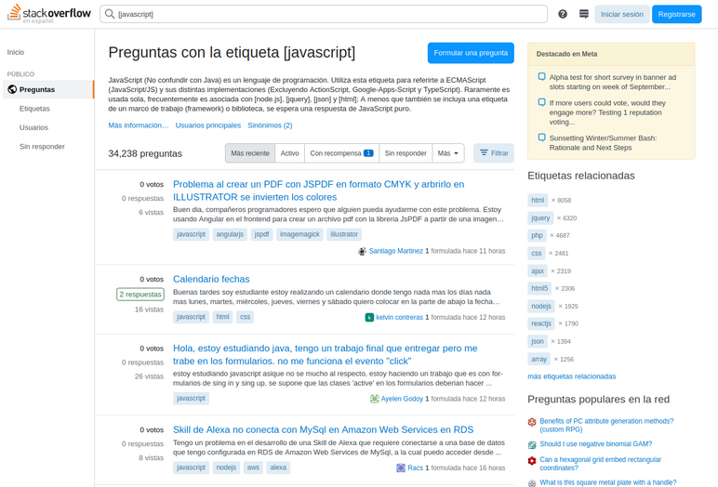
Looking for help
2.- Introduction to client-side programming > Programming tools
StackOverflow is the place to go when you have any question. English and Spanish

Slide 28
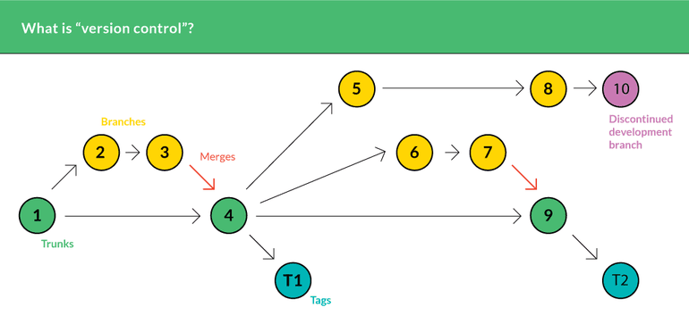
Benefits of using a version control system
2.- Introduction to client-side programming > Programming tools > version control system
Tracks changes on source code over time allowing to revert them
Prevents source code from accidental changes
Allows users to work at the same time, on different parts of the same code and eventually merge them
Allows moving along versions effortlessly
Avoids having to use messy file names like “definitivo”, “último”, “final”, “final v1”,...

Slide 29
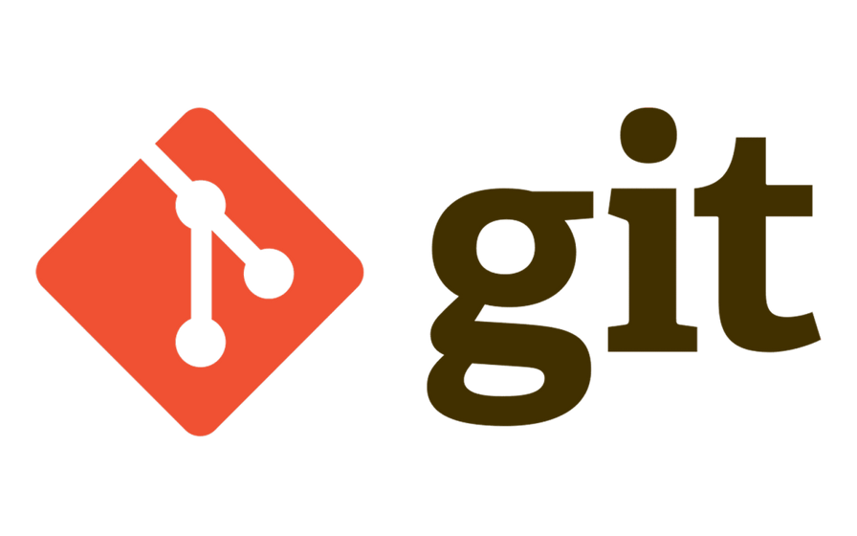
Git
2.- Introduction to client-side programming > Programming tools > Version control system
It is a distributed control version system
It is not the only one, but it is the de facto standard
It is free and open source
There are several websites working with Git system (github, gitlab, bitbucket)...

Slide 30
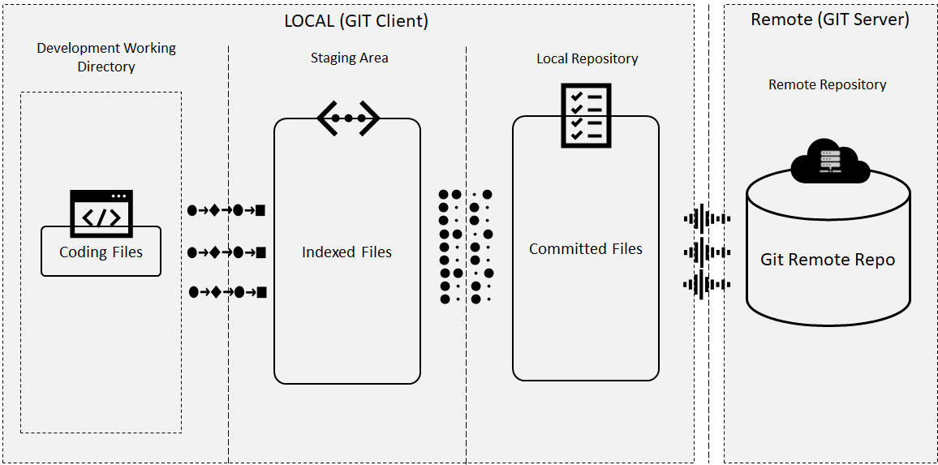
Basic concepts
2.- Introduction to client-side programming > Programming tools > Version control system
BAsic concepts: remote repository, local repository, staging area, working directory

Slide 31
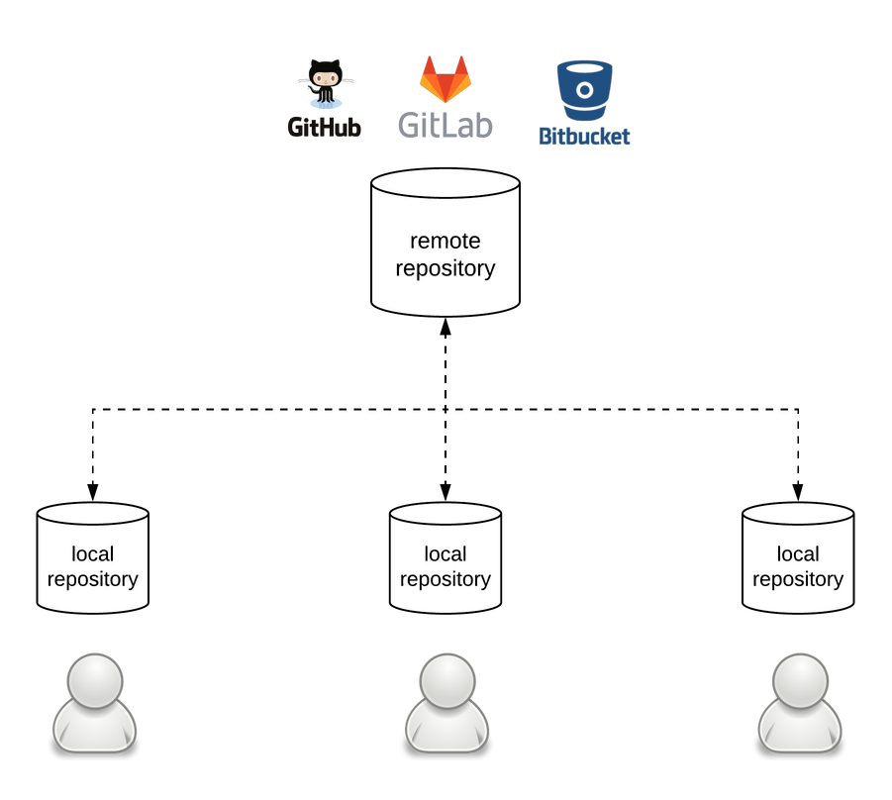
Basic concepts
2.- Introduction to client-side programming > Programming tools > version control system
Remote repository
Contains a master copy of the whole project
Each developer copies (clone) remote repository into his local repository
Local repository
Contains the original project modified by the developer
When a milestone is reached, code is uploaded to remote repository
If something breaks at local, a copy of remote repository can be cloned again

Slide 32
Basic concepts
2.- Introduction to client-side programming > Programming tools > version control system
Staging area
Intermediate storage area prior to update local repository
It implies information about local changes being stored in ./git/index file
Working directory
Directory where remote repository is donwloaded (cloned)
Is where developer will work at

Slide 33
Basic workflow
2.- Introduction to client-side programming > Programming tools > Version control system
1
Create a remote repository
Clone remote repository
2
2
Link to an existing remote repository
3
Authenticate yourself
4
Create or modify files
5
Add to stage area
6
Add to local repository
7
Add to remote repository

Slide 34
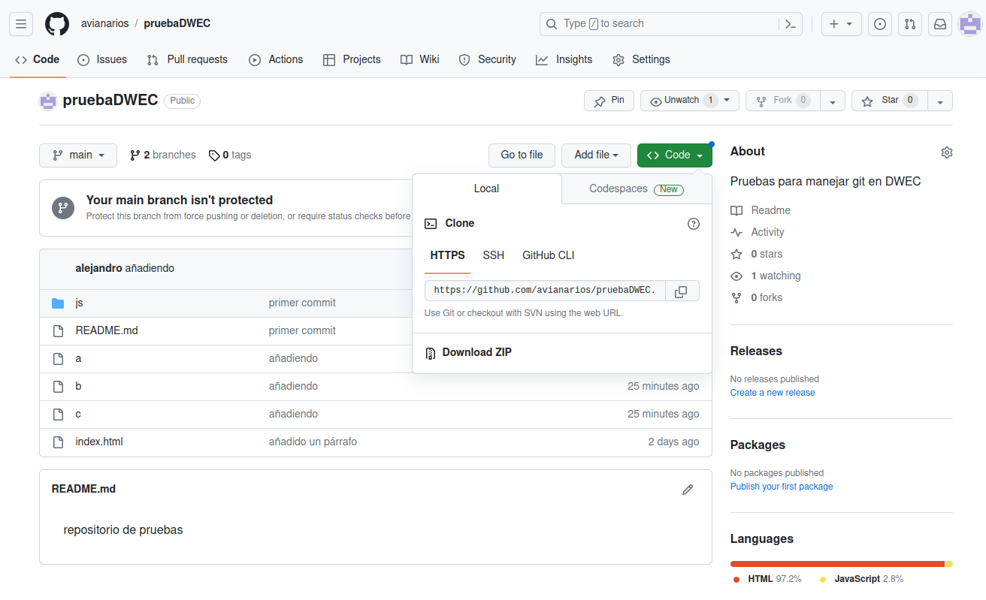
Cloning an already existent github project
2.- Introduction to client-side programming > Programming tools > Version control system
How to get HTTPS URL, needed to clone a remote repository

Slide 35
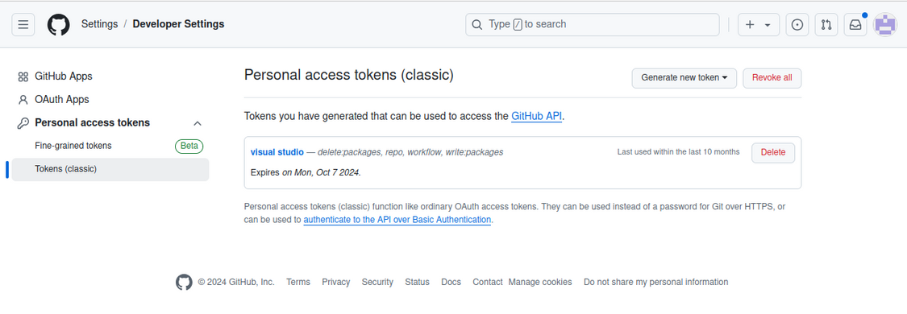
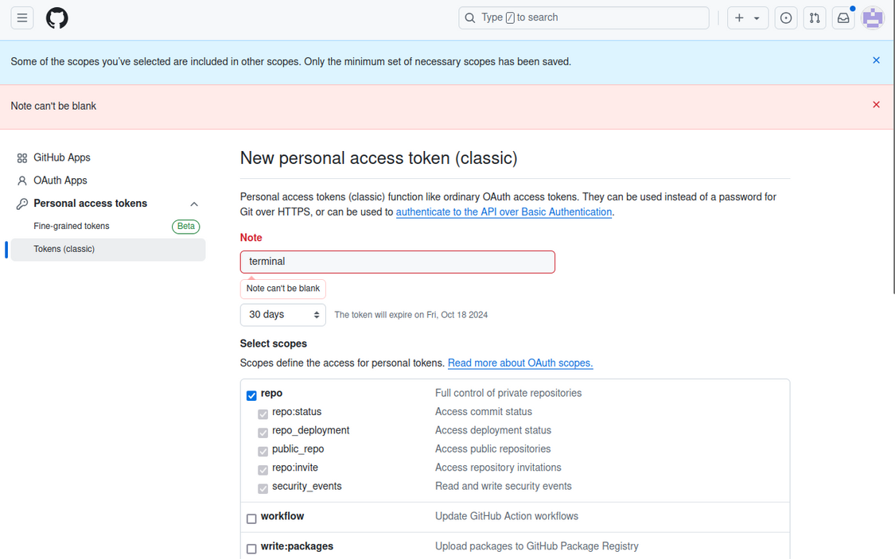
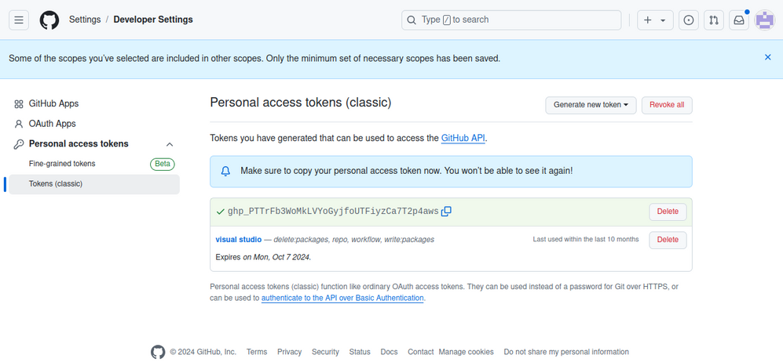
Identifying
2.- Introduction to client-side programming > Programming tools > Version control system
How to create a token, needed to login by using HTTPS

Slide 36
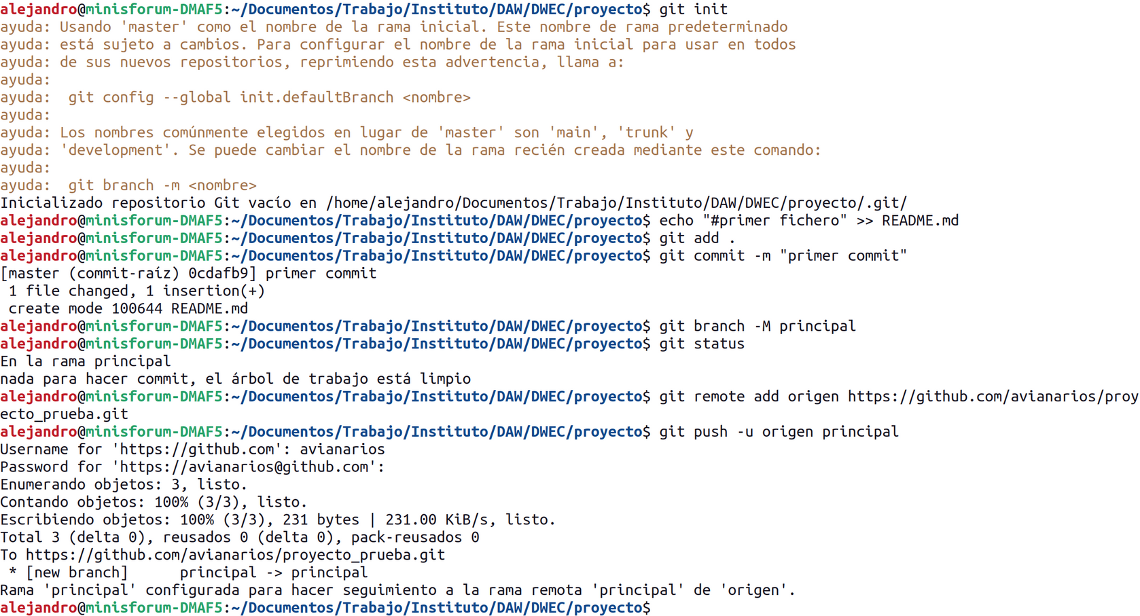
Basic workflow
2.- Introduction to client-side programming > Programming tools > Version control system
Initialize local repository
Create a local file
Add changes to stage
Add changes to local repository
Rename “master” branch to “principal” (optional)
Add a remote origin as “origen”
Add changes to remote repository (use username and token)
Option 1: Create a remote repository and link it to an existing local directory

Slide 37
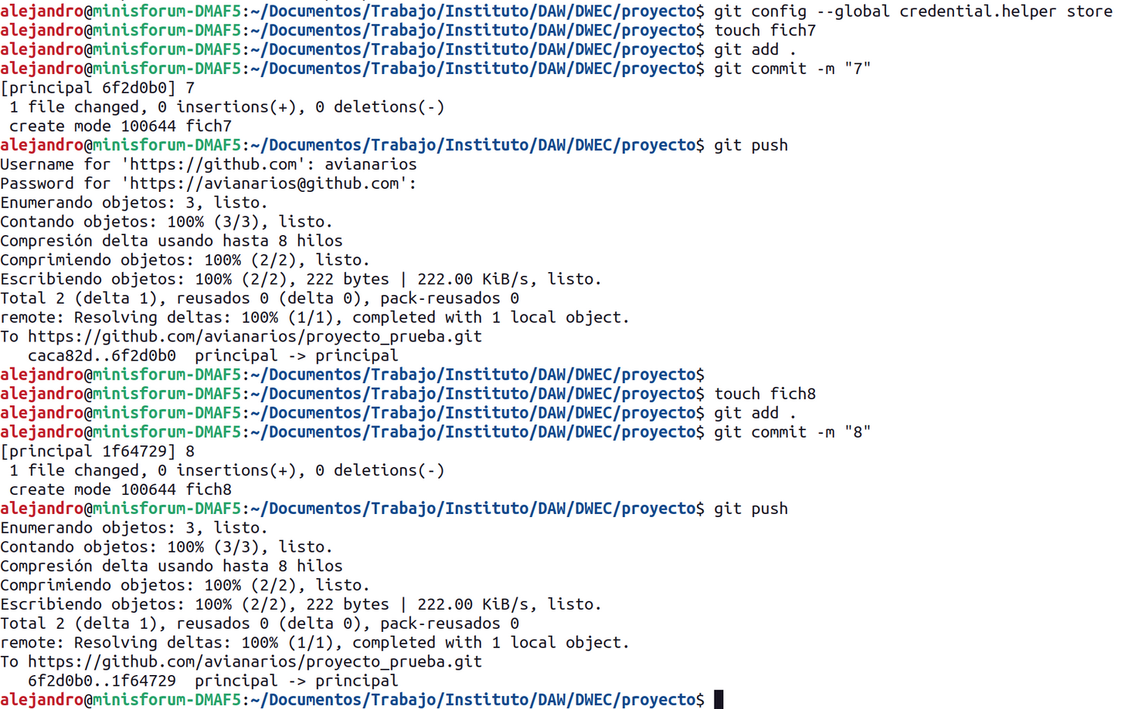
Storing credentials
2.- Introduction to client-side programming > Programming tools > Version control system
HTTPS is the basic way to authenticate. In order to avoid git asking credentials every time, they can be saved in a plain text (not very safe!) by using git config --global credential.helper store

Slide 38
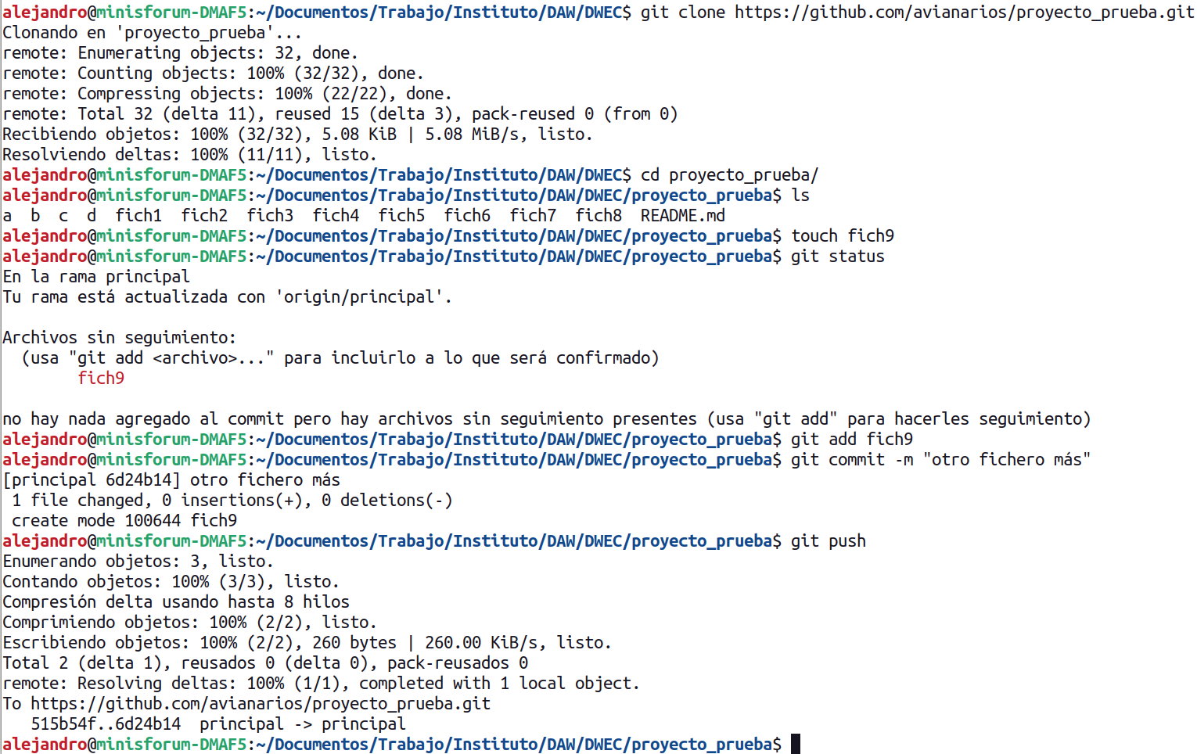
Cloning an already existent github project
2.- Introduction to client-side programming > Programming tools > Version control system
Option 2: clone a remote repository into an existing local directory

Slide 39
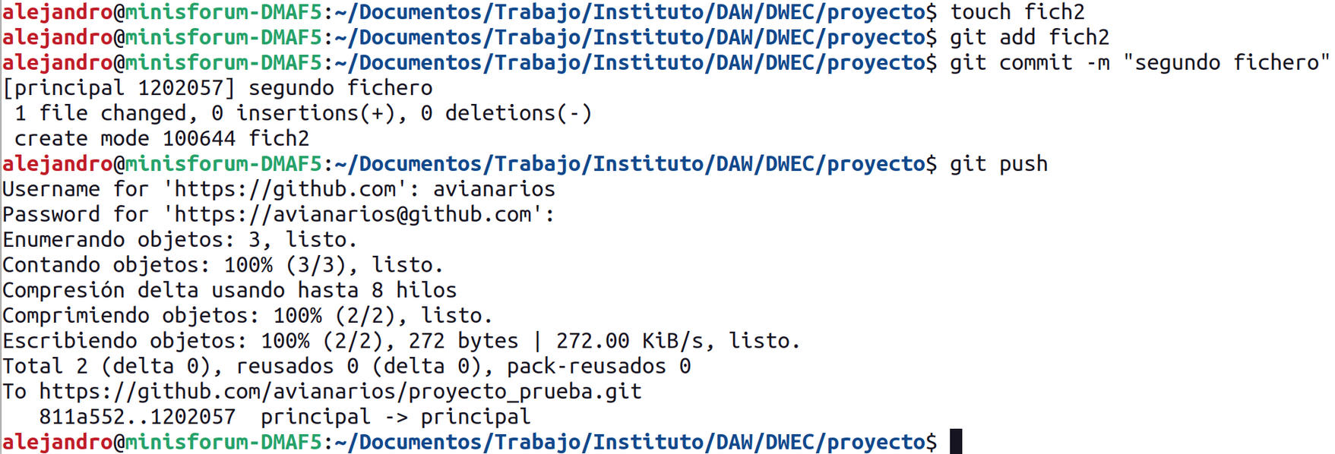
Basic workflow
2.- Introduction to client-side programming > Programming tools > Version control system
First time push is done a relationship between local branch “principal” and remote branch has to be stablished. That’s why git push -u “remote_server” “local_branch” was used.
Once stablished, you can just use git push

Slide 40
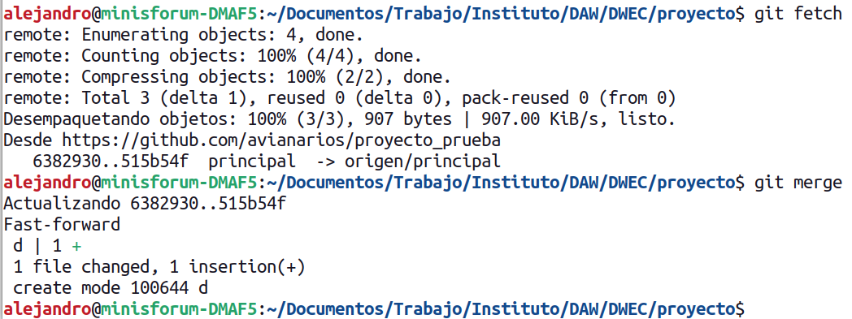
Getting remote changes
2.- Introduction to client-side programming > Programming tools > Version control system
git fetch bring information about what has changed in remote server but without changing your local repository
git merge bring the remote changes and stores in your local repository
git pull is equivalent to git fetch+git merge

Slide 41
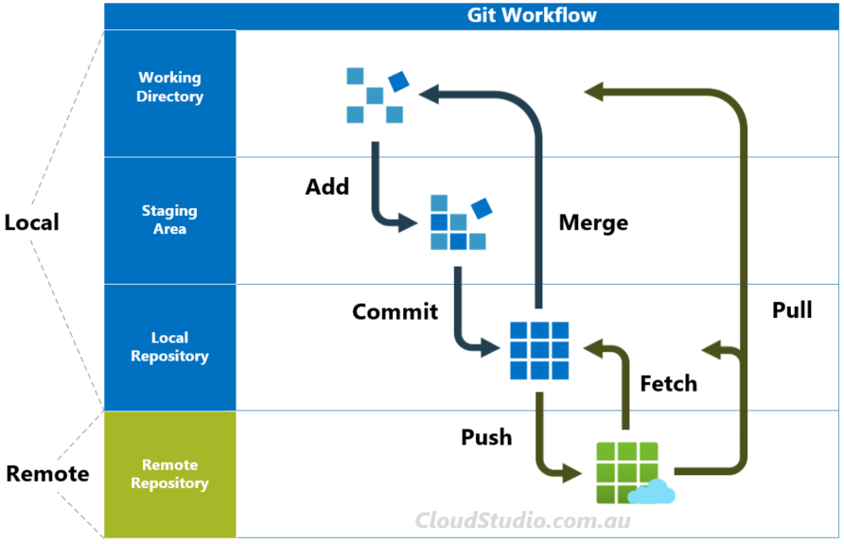
Version control system
2.- Introduction to client-side programming > Programming tools
concept of git

Slide 42
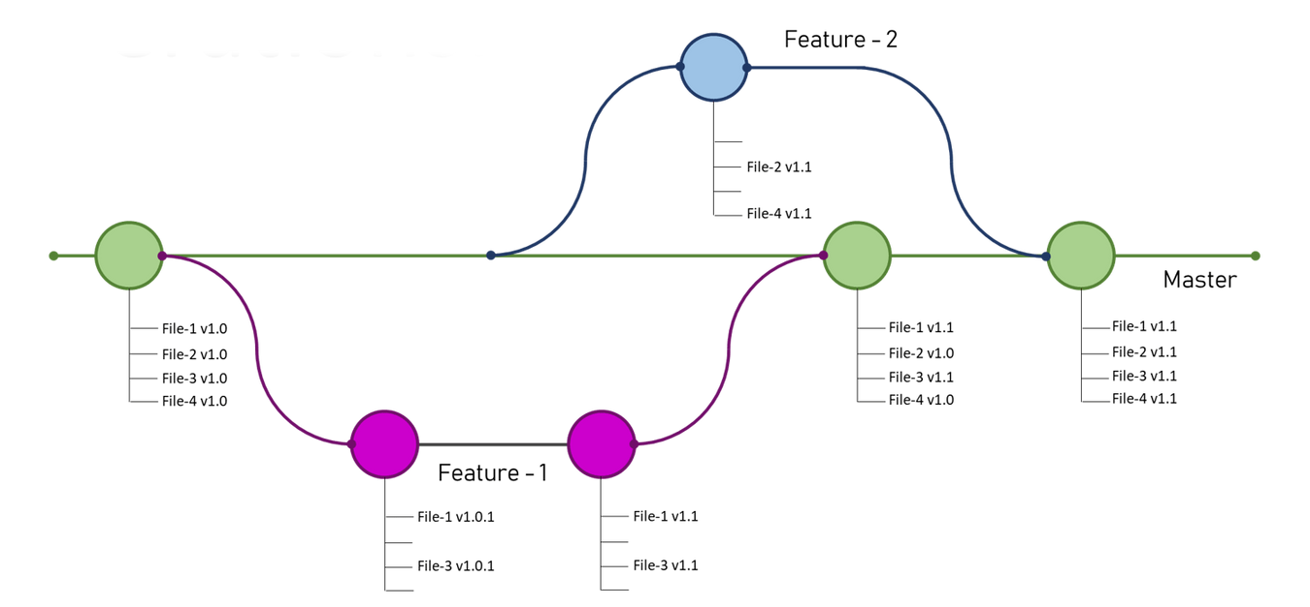
Branches
2.- Introduction to client-side programming > Programming tools > Version control system
Master branch should contain only well-tested, working code.
A replica of master must be taken when programmer wants to make changes and improvements.
Once finished and tested, branch is merged with master.

Slide 43
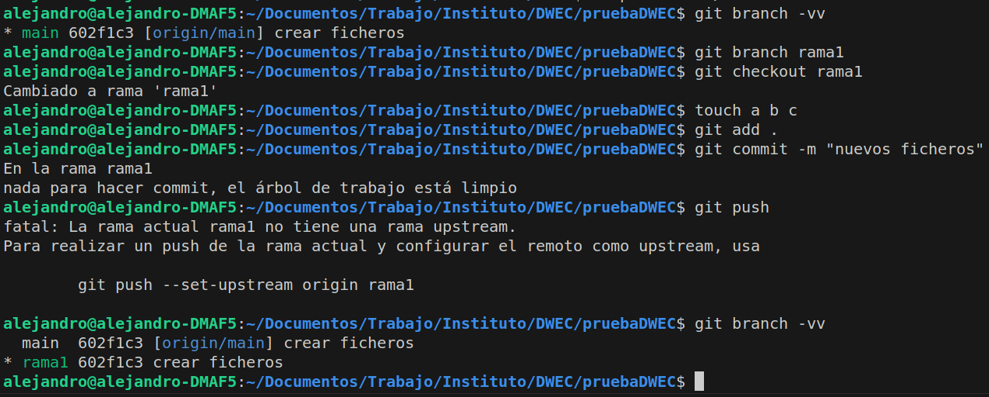
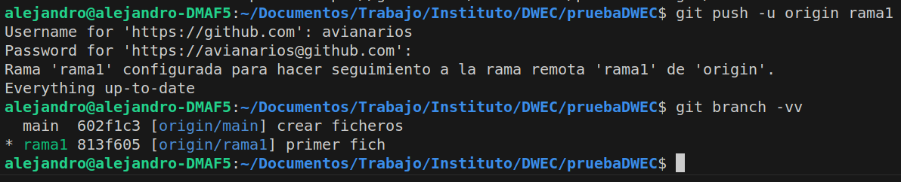
Version control system
2.- Introduction to client-side programming > Programming tools
Creating first branches
There are two concepts related with remote repository
remote server pull is going to take files from (origin)
remote repository push is going to upload to (upstream)
When creating local branches, there is no origin nor upstream so they must be set at first push (git push --set-upstream origin rama1 or git push -u origin rama1)

Slide 44
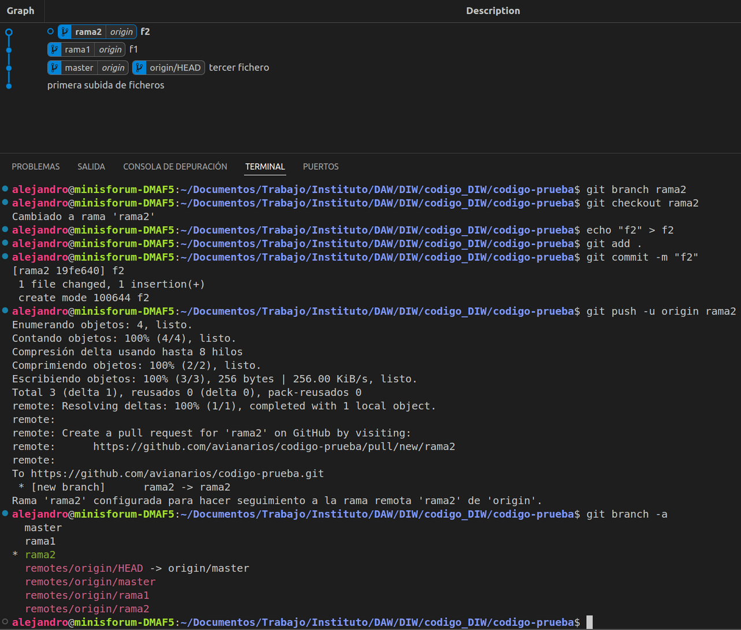
Version control system
2.- Introduction to client-side programming > Programming tools
Branch creation

Slide 45
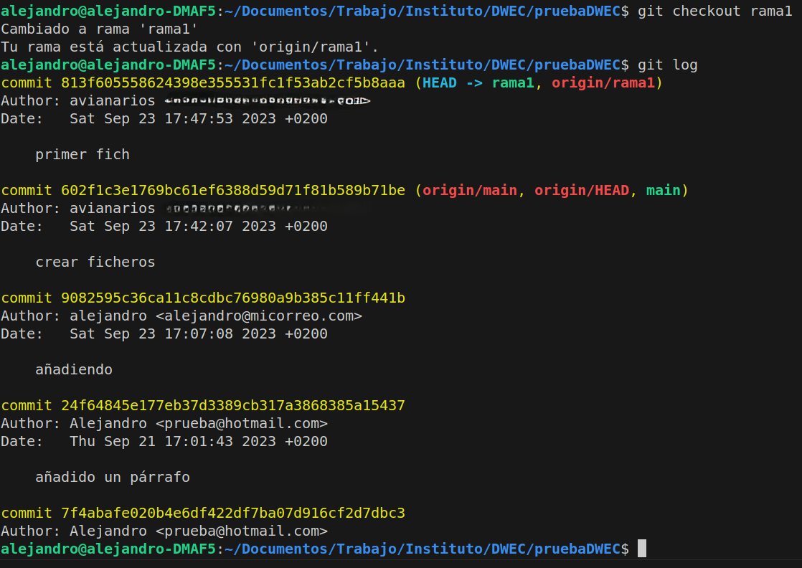
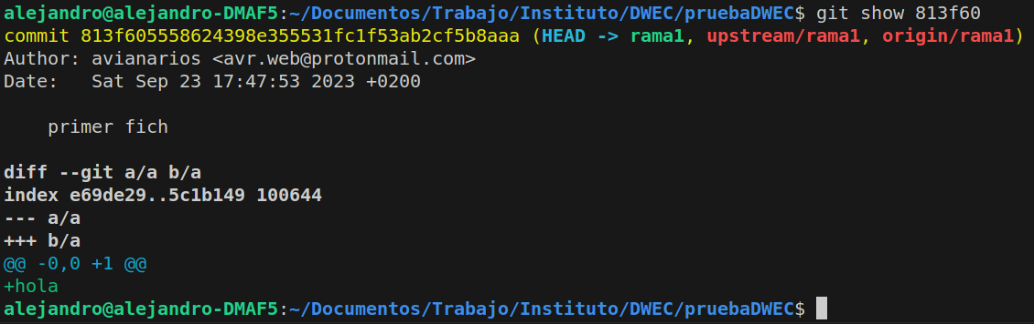
Reverting changes
2.- Introduction to client-side programming > Programming tools
Reverting changes
There is log storing all commits
git log -> shows actual branch info
git log --all -> shows all branches info
each commit has an ID

Slide 46
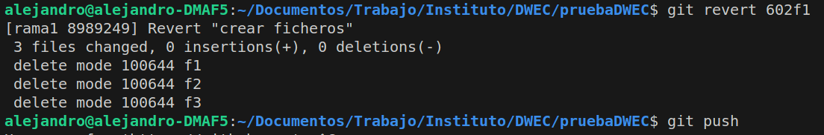
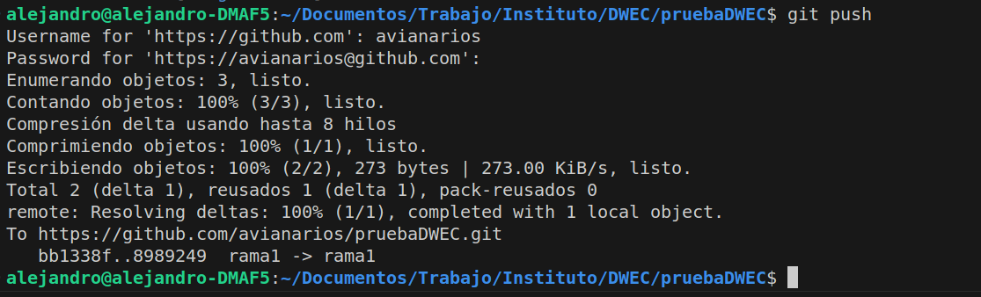
Reverting changes
2.- Introduction to client-side programming > Programming tools > Version control system
git revert only needs the firsts ID characters
git push is needed as changes are performed only in local repository

Slide 47
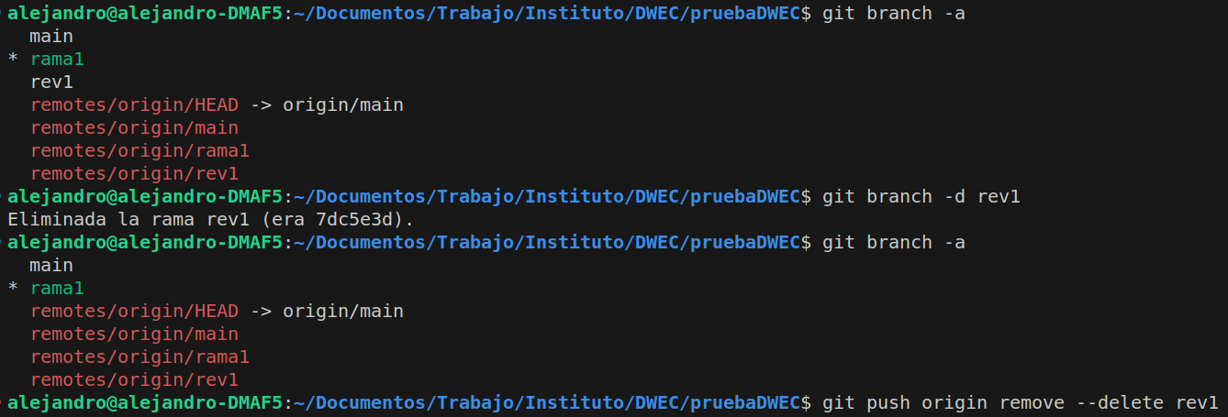
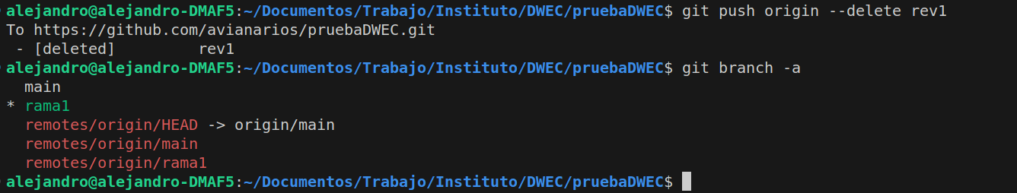
Creating and removing branches
2.- Introduction to client-side programming > Programming tools > Version control system
How to remove branches, locally and remotely
-a lists remote and local branches
-d removes locally. Push must be done in order to remove remotely

Slide 48
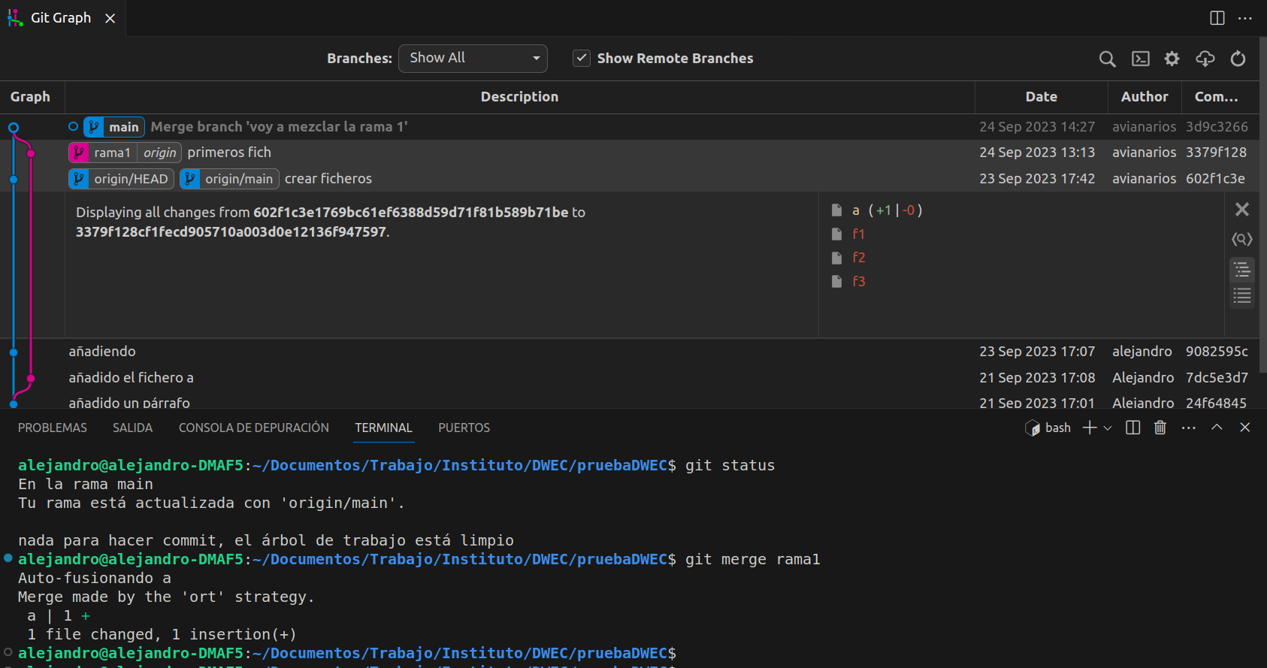
Merging branches
2.- Introduction to client-side programming > Programming tools > Version control system
git merge rama1 incorporates changes from the branch “rama1” into the current one

Slide 49
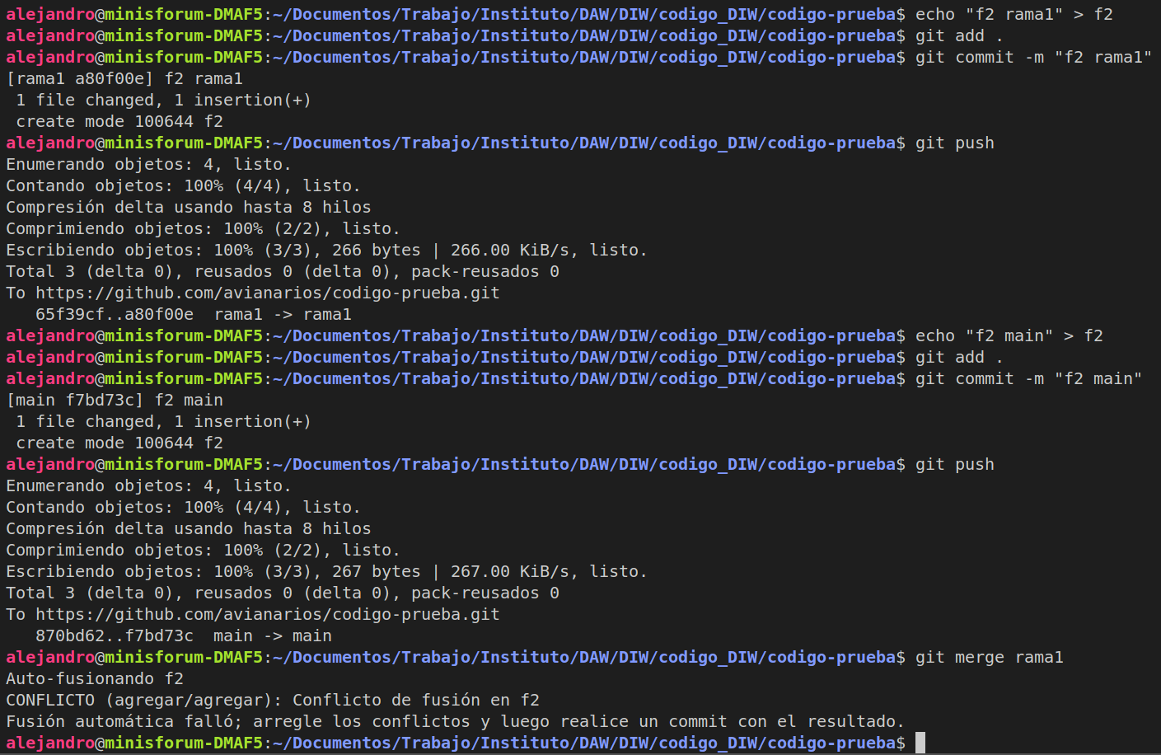
Conflict resolution
2.- Introduction to client-side programming > Programming tools > Version control system
merging can result in conflicts when the same file has different content at different branches

Slide 50
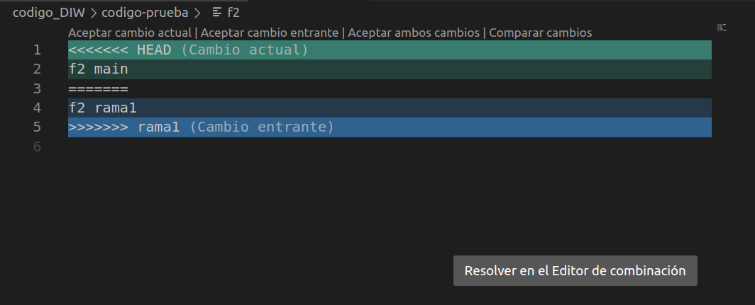

Conflict resolution
2.- Introduction to client-side programming > Programming tools > Version control system
conflicts can be solved by opening the file with nano or VS code and selecting information to be kept

Slide 51

Checking differences between branches
2.- Introduction to client-side programming > Programming tools > Version control system
How to check differences between branches

Slide 52
More actions
2.- Introduction to client-side programming > Programming tools > Version control system
It can do a lot more...
Rebase (similar to merge but makes the commit tree linear) -> git rebase rama_a_rebasar
Detach HEAD -> git checkout commit_id
Move along commit tree -> git checkout HEAD^ or git checkout HEAD~3
Reassign a branch to a commit -> git branch -f main HEAD~3 (with a detached HEAD)
Incorporate some commits to current branch -> git cherry-pick commit_id1 .... commit_idn
Interactive rebase (-i option. Avoids having to know commits id) -> git rebase -i HEAD~4

Slide 53
3.- Introduction to JavaScript
What is JavaScript?
What in-browser JavaScript can and can’t do?
JavaScript versions
JavaScript engines
JavaScript-based languages

Slide 54

What is Javascript?
3.- Introduction to JavaScript
Interpreted high-level Programming language used to provide interaction to websites
Alongside HTML and CSS, it’s the third technology absolutely essential in website creation
Traditionally clien-side but, thanks to Node, also server-side
a Javascript code
a Javascript code

Slide 55
What in-browser Javascript can and can’t do?
3.- Introduction to JavaScript
What can be done?
What can’t be done?
Modify an HTML document. Anything
React to user actions
Interact with remote servers
Running code in response to events
Work with cookies
Work with browsers’ APIs: DOM, Geolocation, Audio, Video, Canvas (2D graphics) and WebGL (render 2D and 3D graphics).
Work with third parties’ APIs
Interact with other tabs or windows
Communicate with other servers different where the page came from without permission
Read or write files on hard disk without permission
Execute programs
Acess to camera or microphone without permission

Slide 56
JavaScript versions
3.- Introduction to JavaScript
Netscape, creator of JavaScript, decides to standardise it by sending it to ECMA (European Computer Manufacturers Association)
There has been lots of versions:
ECMAScript 2015 or ES6
ECMAscript 2017 or ES7
...
Last one is ECMAScript 2023 or ES14
Some of them only bring minor improvements so, for us, it is the same working on ES6 or above

Slide 57
JavaScript engine
3.- Introduction to JavaScript
Is a program that executes JavaScript code
First ones were interpreters. Nowadays they use just-in-time compilation for improved efficiency
Typically developed for web browsers (but not allways)
Most popular:
V8 (Google). Used in Google Chrome, Chromium-based and Edge browsers, as well as Node.js and Deno
SpiderMonkey (Mozilla), used in Firefox and its forks
JavaScriptCore (Apple), used in its Safari browser
Chakra (Microsoft), used in Internet Explorer browser

Slide 58

JavaScript-based languages
3.- Introduction to JavaScript
Other languages
JavaScript syntax does not meets everybody’s needs
Some languages, similar to JavaScript, have appeared : CoffeScript, TypeScript, etc.
They have to be translated (transpiled) into JavaScript for the browser to execute it.

